Slide 1
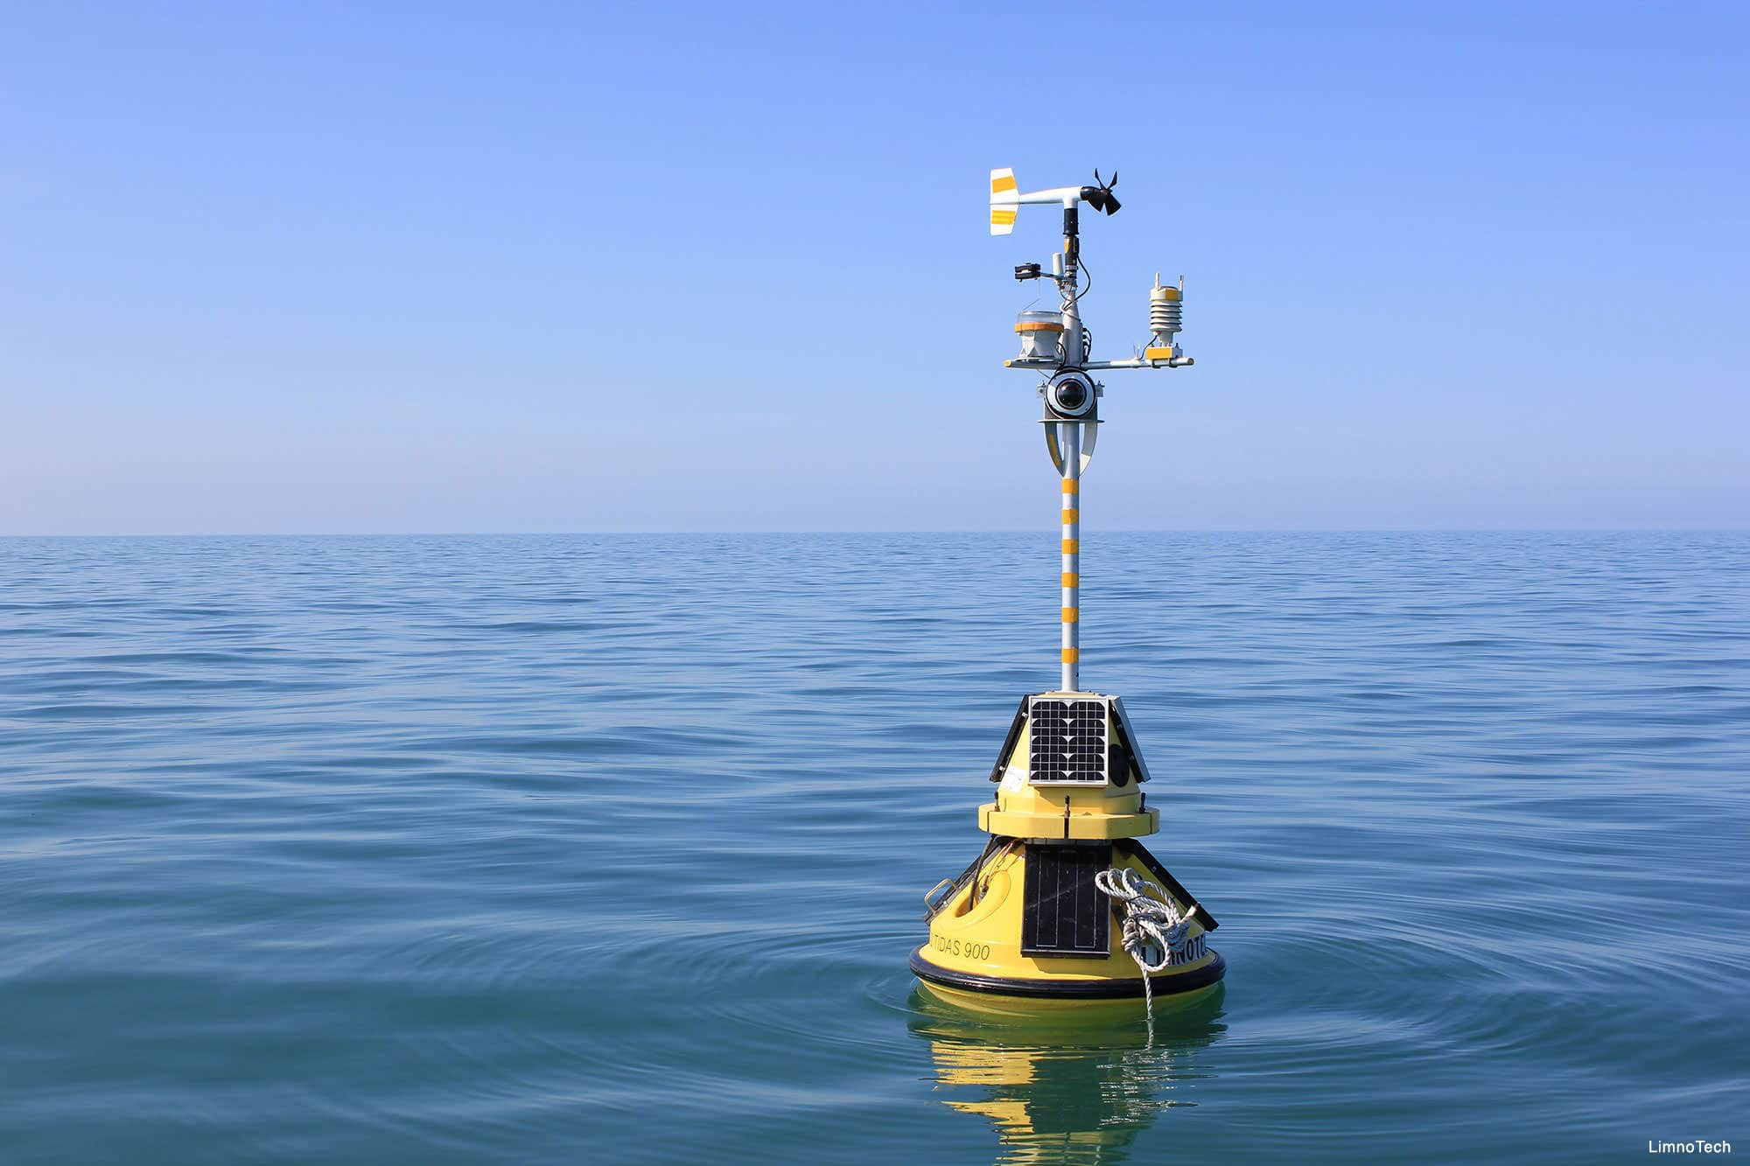
Analysis of Tropical Atmosphere Ocean Data
-- Team Invincibles
Notes:
Hello everyone, this is team invincibles. How’s everyone doing today? Today we are going to present our analysis and results of tropical atmosphere ocean dataset.

Slide 2
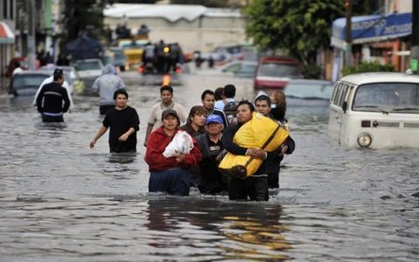
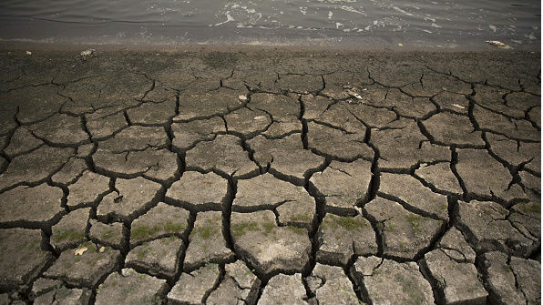
Initiative: El Nino/Southern Oscillation (ENSO)
What is ENSO?
Catastrophic
Flooding, Tornado, Wildfire, etc.
In particular: 1982 - 1983
Predictable
Wind
Sea Surface Temperature
Air Temperature
Their Interactions In Equatorial Pacific Ocean
Notes:
So what is tropical atmosphere ocean data why is it collected? It all starts with ENSO cycle in short for El Nino/Southern Oscillation cycle. I guess most people here have at least heard the concept of El Nino effect, but I am going to show a short video to introduce the concept anyway, so here we go.
From the video, we see that ENSO cycle is catastrophic, it can bring flooding to some parts of the world, while bringing droughts to the other parts. Droughts and flooding are also accompanied with tornados, hurricanes, wildfires and a number of other extreme weather conditions. These events bring loss to mankind.
In particular, the 1980s was hit hard by el nino. I will quote an article from Washington Post to describe what happened then.
It [1982-1983 El Nino event] led to droughts in Indonesia and Australia, widespread flooding across the southern United States, lack of snow in the northern United States, and an anomalously warm winter across much of the mid-latitude regions of North America and Eurasia. The estimated global economic impact was over US$8 billion. This El Niño event also led to an abnormal number of hurricanes in the Pacific Ocean during this time span; the strongest hurricane up to 1983 hit Hawaii during the event.
What’s worse was that the ENSO cycle during this period was not detected until its peak. But we learn from the video that ENSO is predictable for the most part as long as wind, sea surface temperature, air temperature and their interactions at the origin of ENSO, which locates in the middle of Pacific Ocean are monitored closely. So how do we measure these variables?

Slide 3
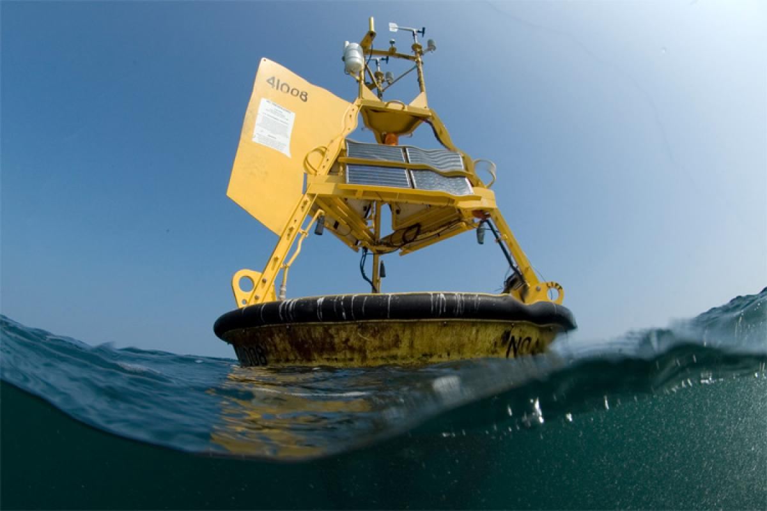
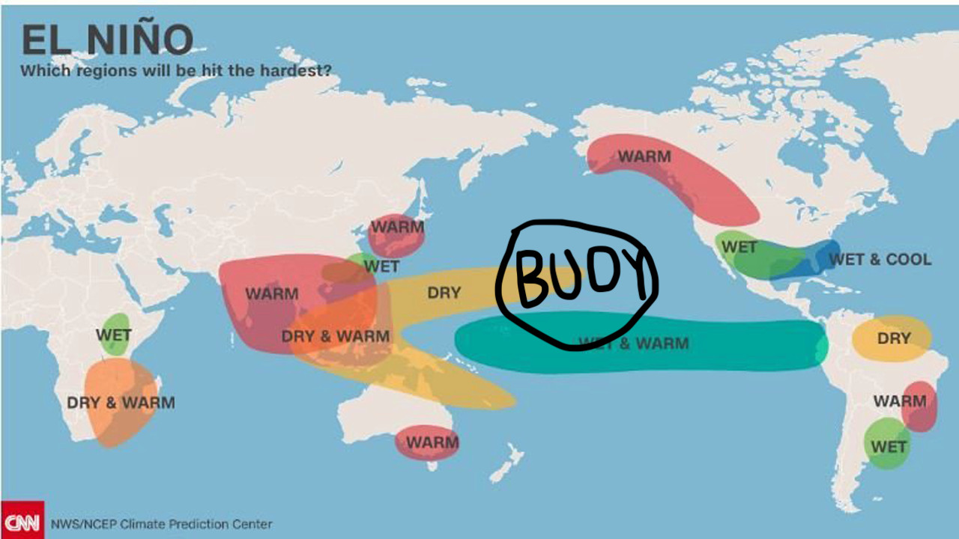

Buoys & TOGA
A Buoy. Where is it? What data it collects?
Zonal Winds (West-East); Meridional Winds(South-North)
Humidity
Air Temperature; Sea Surface Temperature;
Date/Location
Tropical Ocean Global Atmosphere Program (TOGA)
Charlie the smart guy found it:)
Notes:
The anwer, my friend, is a buoy. An example of a buoy deployed in the ocean is shown on the top right of this slide. It collects data reflecting air temperature, sea surface temperature and wind via sensors. The buoys to monitor the ENSO cycle are mostly deployed near equatorial pacific ocean, where ENSO cycles originate, as labeled in the image on the bottom right. And these buoys collect seven data variables, they are: xxxxxx.
A total number of 70 buoys were deployed by the International Tropical Ocean Global Atmosphere program (TOGA) successively with an urgent need to monitor El Nino effect during the 1980s, some were implemented earlier than others. These data were stored at UCI machine learning repository and was made available on Kaggle. Charlie found it. This is the basic idea behind our dataset. Without further due, I will pass on to my teammate Robert to discuss the process of data preparation for our project.

Slide 4
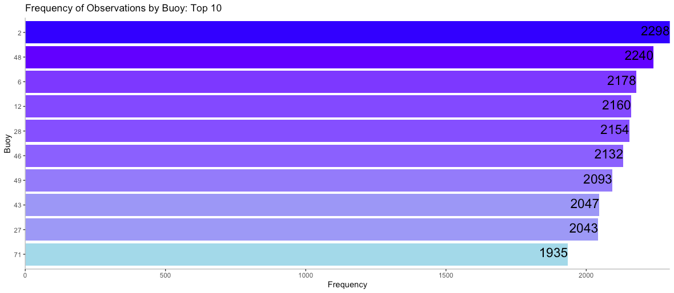
Data Preparation
From 1980 to 1998
Label buoys
72 buoys
Missing not at Random (MNAR)
Selected Top 2
Buoy 2
Buoy 48

Slide 5
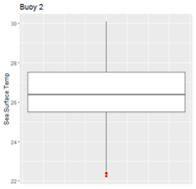
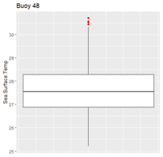
Descriptive statistics
Similar weather patterns
High correlations among predictors
Buoy 48 located in warmer weather

Slide 6


Model Comparison
Model Comparison
VS

Slide 7
Round 1: Linear Regression
Buoy 2: 2,298 entries
Target: sea surface temperature
1
Predictors:
monthly dummies
zonal winds
meridional winds
humidity
air temperature
interaction and squared terms.

Slide 8
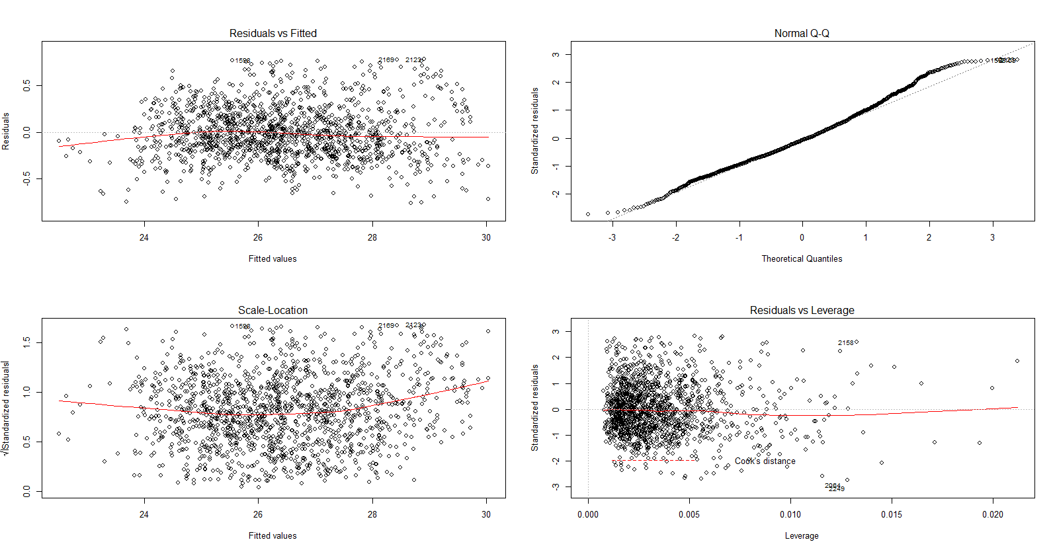
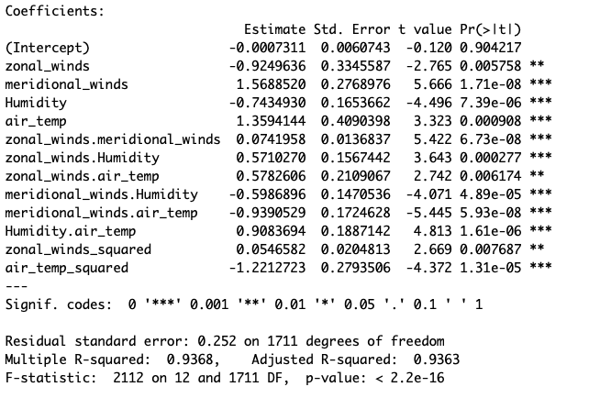
Adjusted R-squared: 0.9363
RMSE: 0.2673

Slide 9
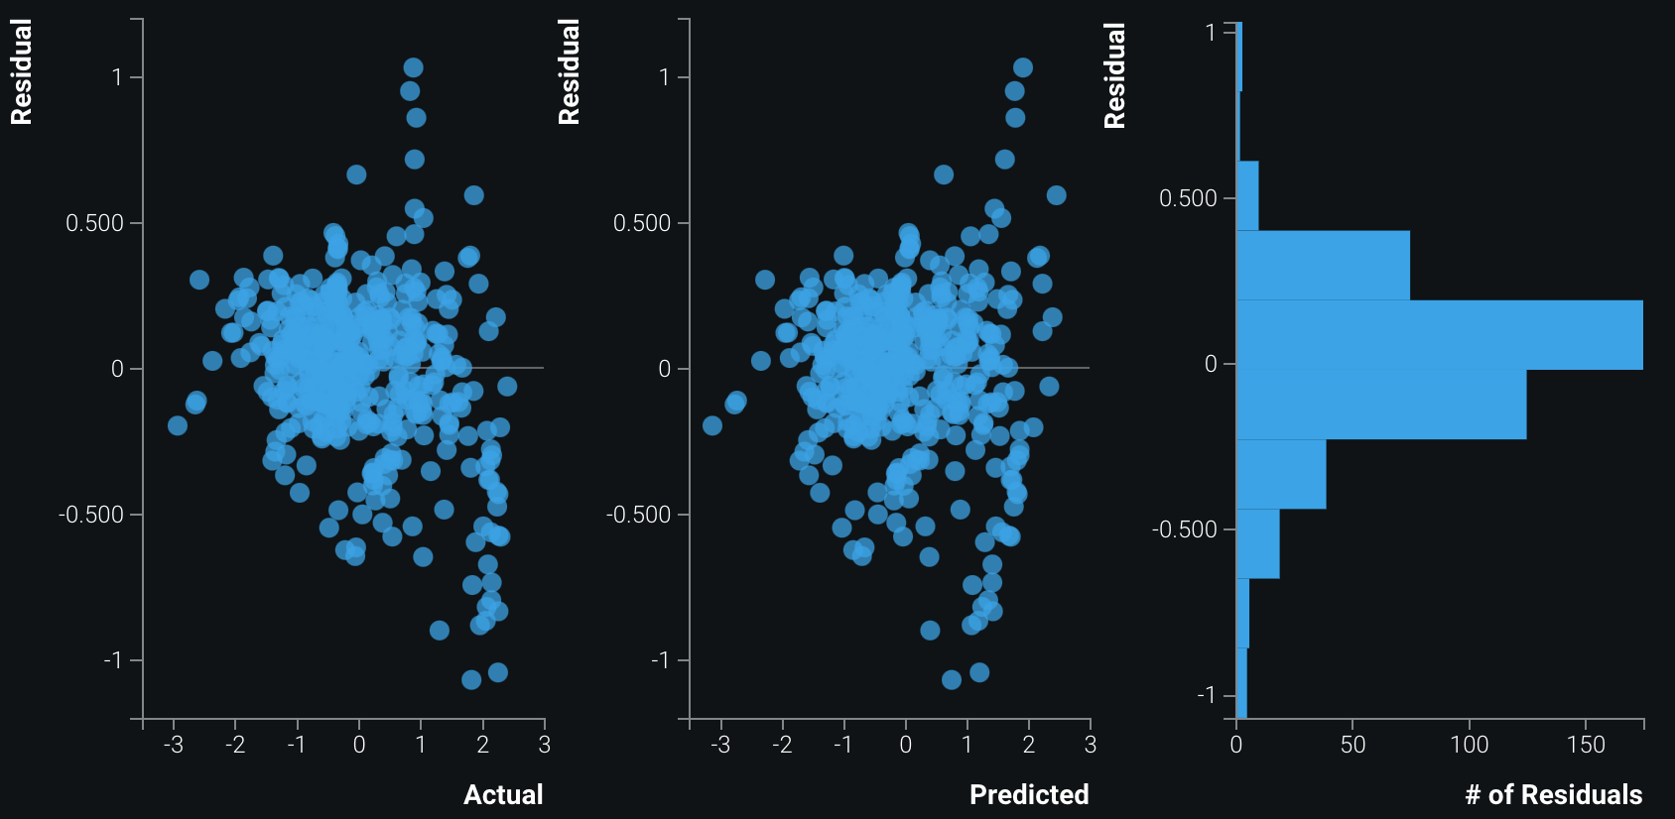
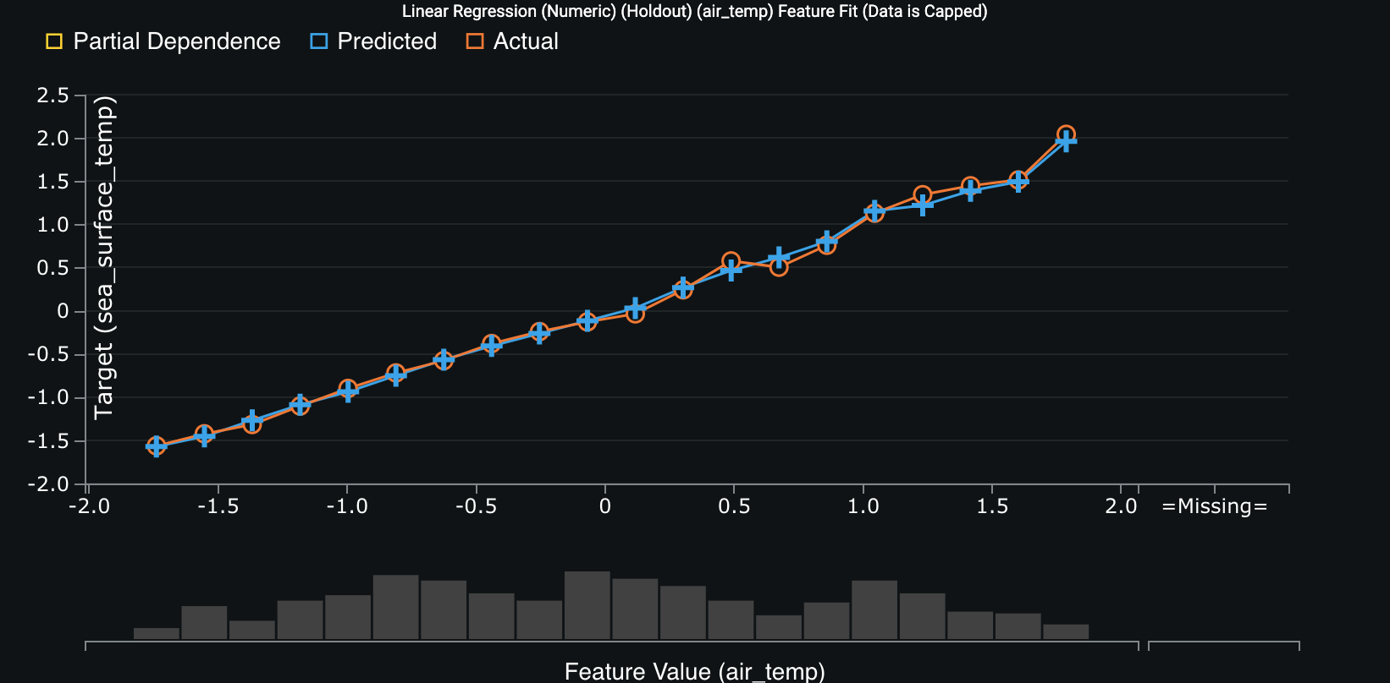
Adjusted R-squared: 0.9323
RMSE: 0.2701

Slide 10
Adjusted R-squared: 0.9363
RMSE: 0.2673
TIE
Adjusted R-squared: 0.9323
RMSE: 0.2701

Slide 11
Round 2: Classification
K-Nearest Neighbours
Buoy 2: 2,298 entries
Buoy 48: 2,240 entries
Target: Buoy
2
Predictors:
zonal winds
meridional winds
humidity
air temperature
sea surface temperature
interaction and squared terms.

Slide 12
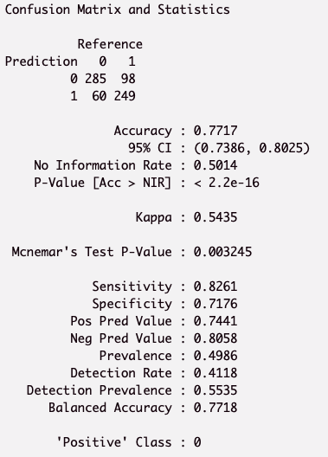
Accuracy: 0.7717
Sensitivity: 0.8261
Specificity: 0.7176
Optimal K: 3

Slide 13
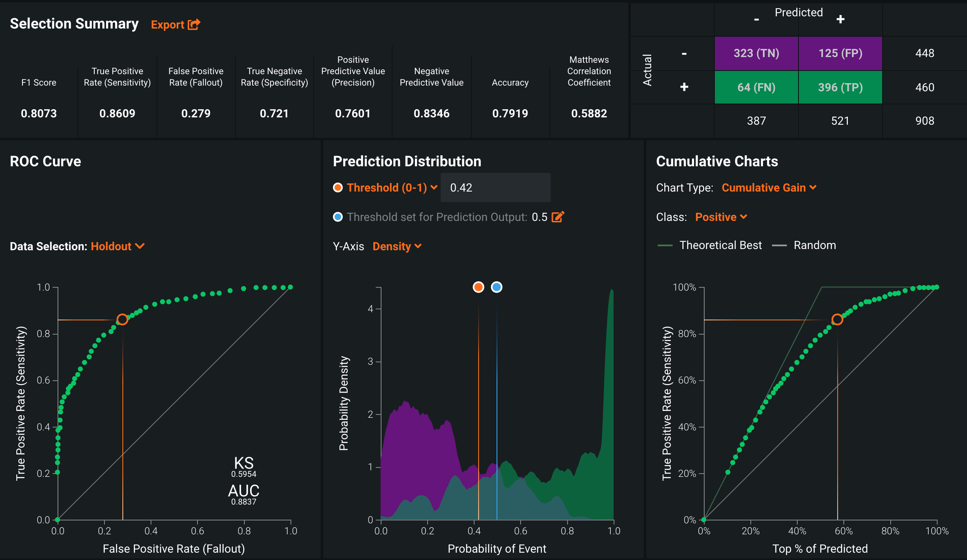
Accuracy: 0.7919
Sensitivity: 0.8609
Specificity: 0.721

Slide 14
Accuracy: 0.7919
SLIGHTLY BETTER
Accuracy: 0.7717

Slide 15
Round 3: Classification
Decision Trees
Buoy 2: 2,298 entries
Buoy 48: 2,240 entries
Target: Buoy
3
Predictors:
zonal winds
meridional winds
humidity
air temperature
sea surface temperature
interaction and squared terms.

Slide 16
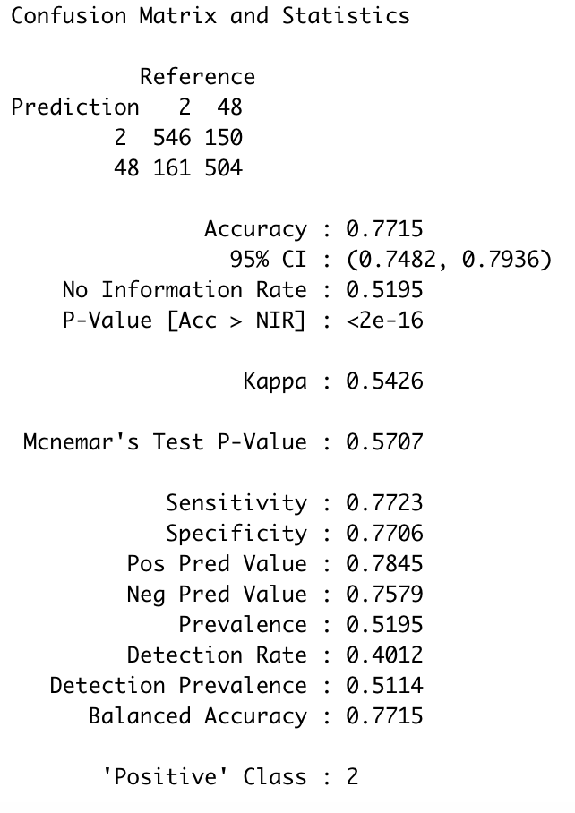
Accuracy: 0.7715
Sensitivity: 0.7723
Specificity: 0.7706

Slide 17
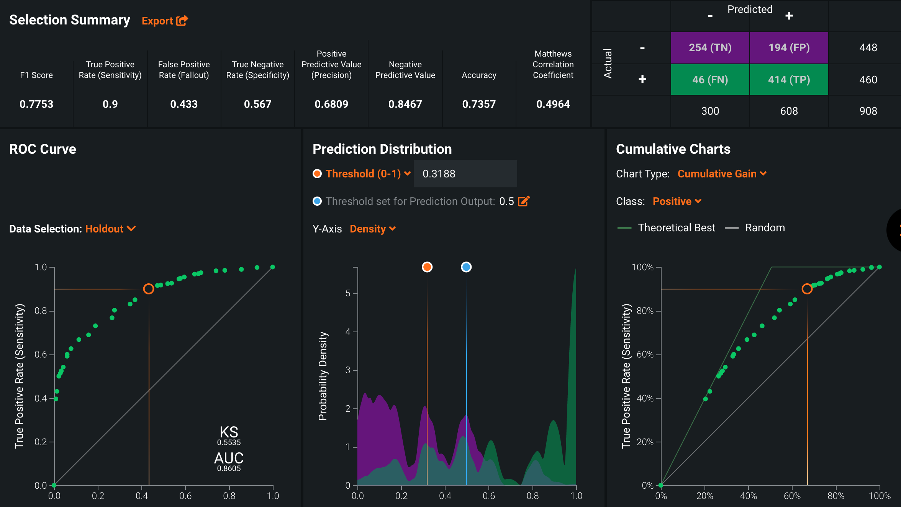
Accuracy: 0.7357
Sensitivity: 0.9
Specificity: 0.567

Slide 18
Accuracy: 0.7715
SLIGHTLY BETTER
Accuracy: 0.7357

Slide 19
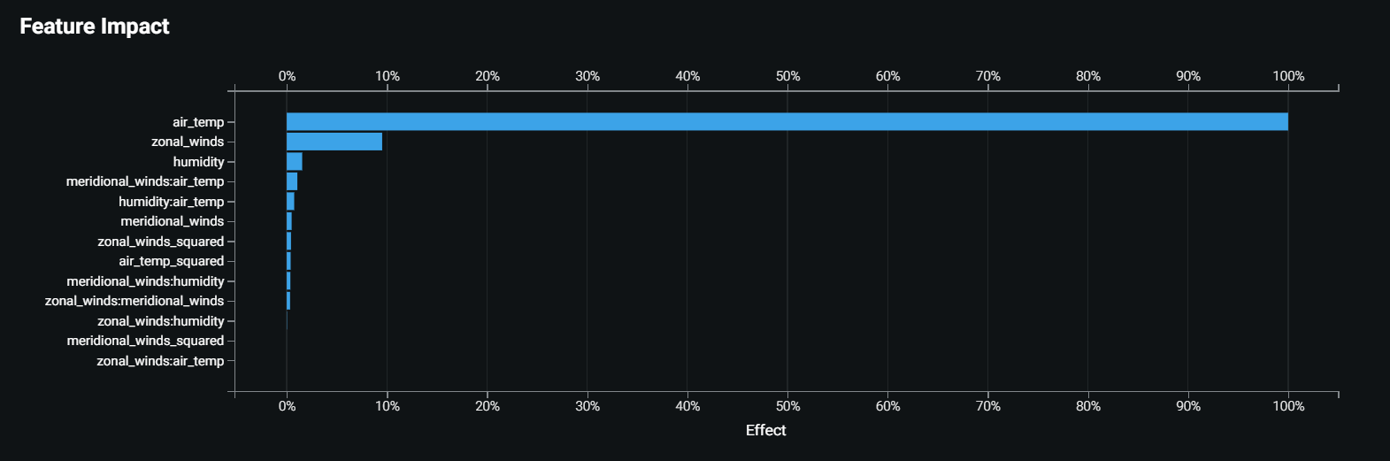
Insights
Linear model to predict sea surface temp
Air temp - similar measurement

Slide 20
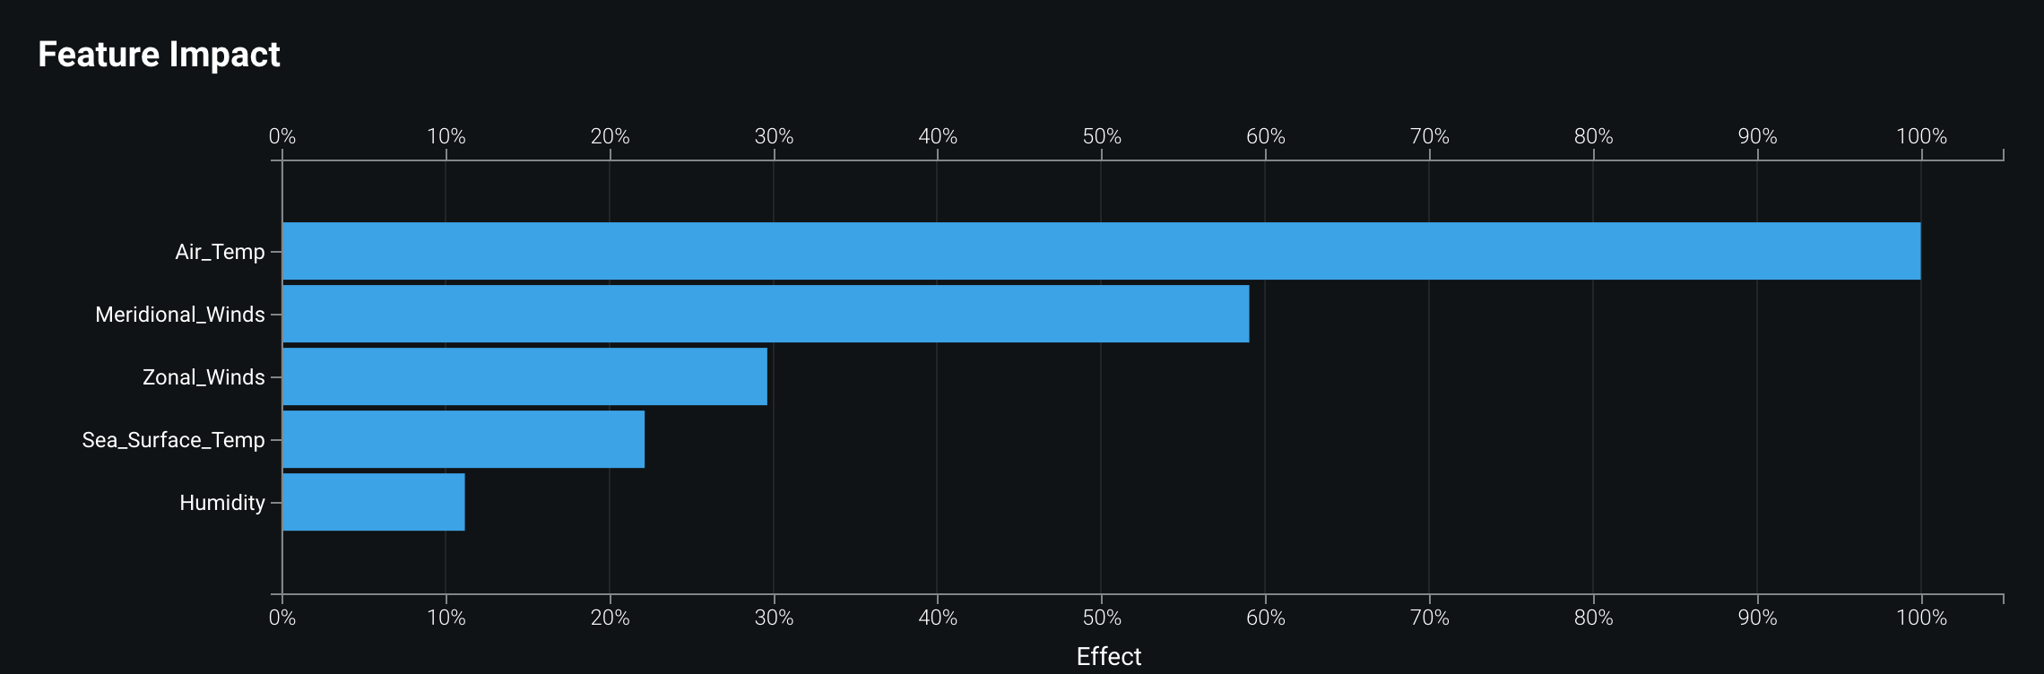
Insights
Classification systems - buoy 2 or buoy 48
Air temp - contains more variation

Slide 21
Conclusion
Challenge: unlabeled data
Solutions: classification & clustering
Our contribution
Generated statistical insights
Further study
Detect unusual sea surface temp
More data: hurricanes, tornadoes
El Nino effect

Slide 22
Questions
Thank You

